Slide 1
LRT3 Website
Proposed content for events & press release
MRCBGK Strategic Communications
9 June 2017

Slide 2
Events
2015
2016
2017
24 May
2017
Tender briefing on 24 May 2017 (supply, delivery, installation, testing and commissioning of fire protection system (Eastern & Western) for Light Rail Transit 3 (LRT3) from Bandar Utama – Johan Setia)
On 24 May 2017, Prasarana Malaysia Berhad (Prasarana) and MRCB George Kent Sdn Bhd (MRCBGK) held a tender briefing for the “supply, delivery, installation, testing and commissioning of fire protection system (Eastern & Western) for Light Rail Transit 3 (LRT3) from Bandar Utama – Johan Setia”. Present at the briefing were Mr. Yazid Ahad, Vice President, Prasarana Rail and Infrastructure Projects Sdn Bhd (PRAISE); Mr. Mohamad Hazlay Hashim, Senior Engineer, Infrastructure Construction Management, MRCBGK; Mr. Mohd Salahuddin Yaacob, Senior Manager, Environmental, Safety & Health (ESH), MRCBGK; Mr. Thong Chong Yong, Senior Manager, Contracts Management, MRCBGK and Mr. Ravendran Rasalingam, General Manager, quality assurance and quality control (QAQC), MRCBGK.
Event Gallery

Slide 3
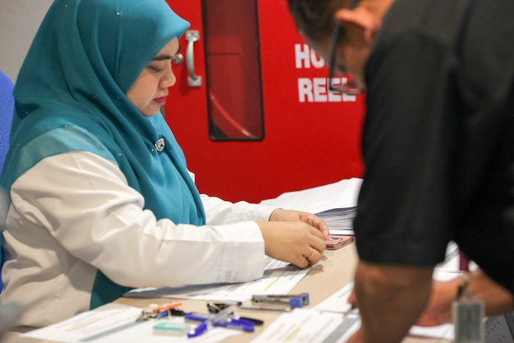
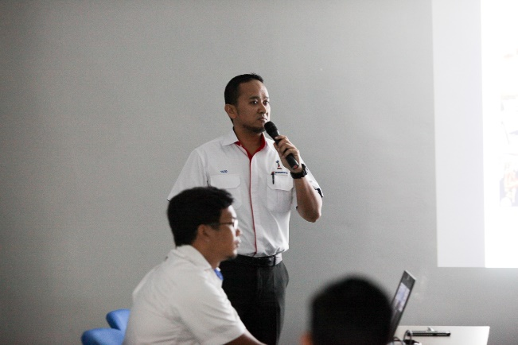
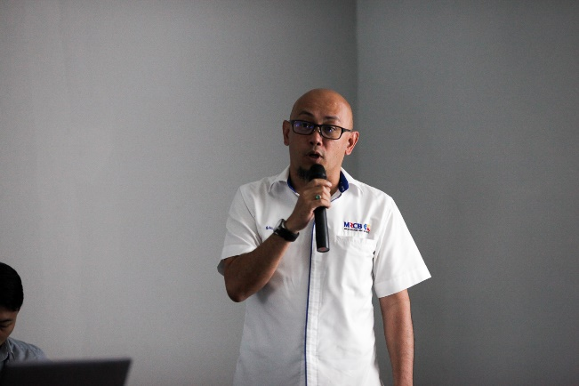
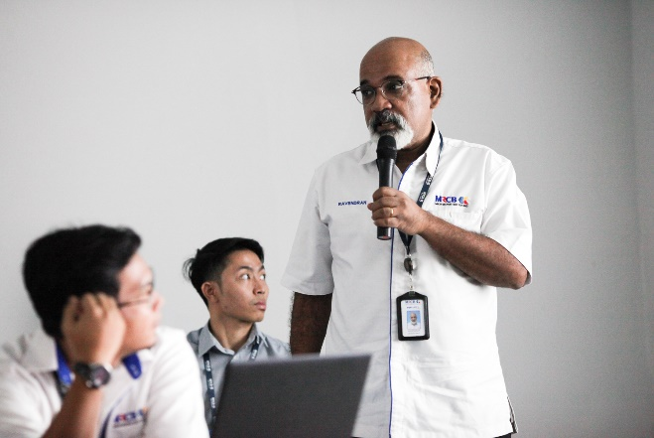
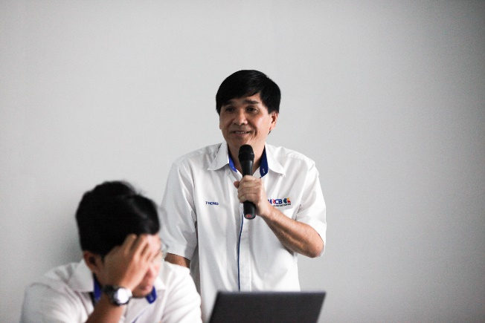
Tender briefing on 24 May 2017 (supply, delivery, installation, testing and commissioning of fire protection system (Eastern & Western) for Light Rail Transit 3 (LRT3) from Bandar Utama – Johan Setia)
Picture
Representatives from pre-qualified contractors registering their attendance.
Mr. Yazid Ahad, Vice President, Prasarana Rail and Infrastructure Projects Sdn Bhd (PRAISE), delivering the opening remarks.
Mohd Salahuddin Yaacob, Senior Manager, Environmental, Safety & Health (ESH), MRCBGK, presenting on the fire protection system package’s ESH requirements.
Mr. Ravendran Rasalingam, General Manager, quality assurance and quality control (QAQC), MRCBGK, presenting on the need for quality assurance and quality control.
Mr. Thong Chong Yong, Senior Manager, Contracts Management, MRCBGK, presenting on the tender requirements.

Slide 4
Events
2015
2016
2017
24 May
2017
Tender briefing on 24 May 2017 (supply, delivery, installation, testing and commissioning of genset for Light Rail Transit 3 (LRT3) from Bandar Utama – Johan Setia)
On 24 May 2017, Prasarana Malaysia Berhad (Prasarana) and MRCB George Kent Sdn Bhd (MRCBGK) held a tender briefing for the “supply, delivery, installation, testing and commissioning of genset for Light Rail Transit 3 (LRT3) from Bandar Utama – Johan Setia”. Present at the briefing were Mr. Ahmad Hakimi Ali, Associate, Prasarana Rail and Infrastructure Projects Sdn Bhd (PRAISE); Mr. Ahmad Ruzaini Redzuan, Engineer, Infrastructure Construction Management, MRCBGK; Mr. Mohd Salahuddin Yaacob, Senior Manager, Environmental, Safety & Health (ESH), MRCBGK; Mr. Thong Chong Yong, Senior Manager, Contracts Management, MRCBGK and Mr. Ravendran Rasalingam, General Manager, quality assurance and quality control (QAQC), MRCBGK.
Event Gallery

Slide 5
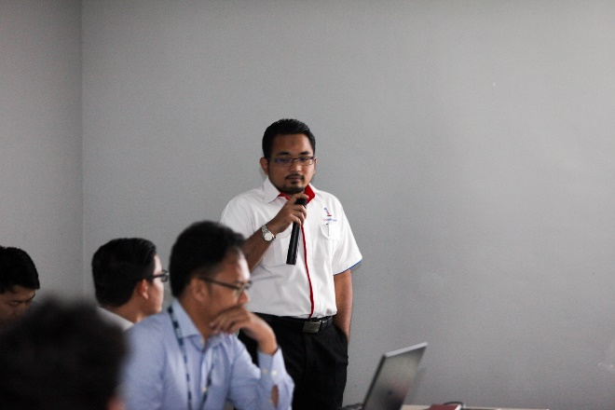
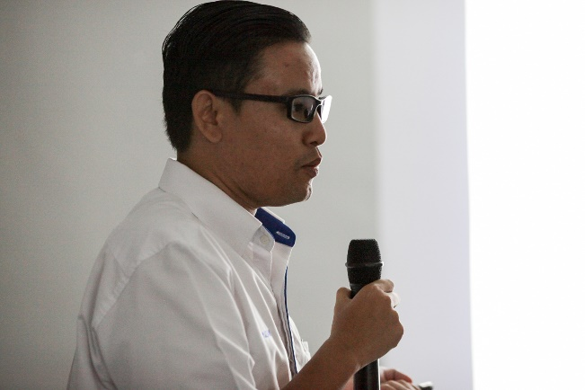
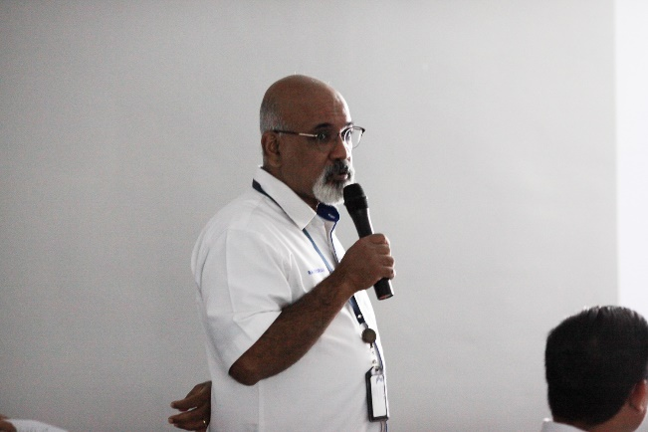
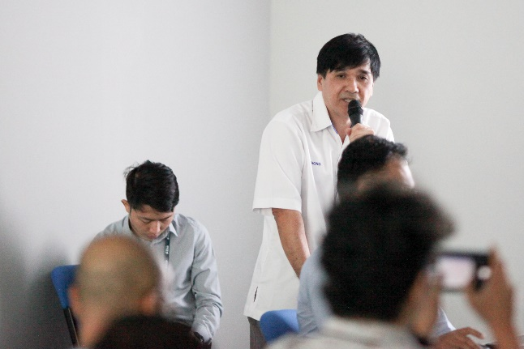
Tender briefing on 24 May 2017 (supply, delivery, installation, testing and commissioning of genset for Light Rail Transit 3 (LRT3) from Bandar Utama – Johan Setia)
Picture
Mr. Ahmad Hakimi Ali, Associate, Prasarana Rail and Infrastructure Projects Sdn Bhd (PRAISE), delivering the opening remarks.
Mr. Ahmad Ruzaini Redzuan, Engineer, Infrastructure Construction Management, MRCBGK, presenting on the technical aspects of the Genset package.
Mr. Ravendran Rasalingam, General Manager, quality assurance and quality control (QAQC), MRCBGK, presenting on the need for quality assurance and quality control.
Mr. Thong Chong Yong, Senior Manager, Contracts Management, MRCBGK, presenting on the tender requirements.

Slide 6
Events
2015
2016
2017
24 May
2017
Tender briefing on 24 May 2017 (supply, delivery, installation, testing and commissioning of air conditioning and mechanical ventilation system for Light Rail Transit 3 (LRT3) from Bandar Utama – Johan Setia)
On 24 May 2017, Prasarana Malaysia Berhad (Prasarana) and MRCB George Kent Sdn Bhd (MRCBGK) held a tender briefing for the “supply, delivery, installation, testing and commissioning of air conditioning and mechanical ventilation system for Light Rail Transit 3 (LRT3) from Bandar Utama – Johan Setia”. Present at the briefing were Mr. Rahizad Rashid, Vice President, Prasarana Rail and Infrastructure Projects Sdn Bhd (PRAISE); Mr. Fadli Naim Md Yusop, Engineer, Infrastructure Construction Management, MRCBGK; Mr. Mohd Salahuddin Yaacob, Senior Manager, Environmental, Safety & Health (ESH), MRCBGK; Mr. Thong Chong Yong, Senior Manager, Contracts Management, MRCBGK and Mr. Ravendran Rasalingam, General Manager, quality assurance and quality control (QAQC), MRCBGK.
Event Gallery

Slide 7
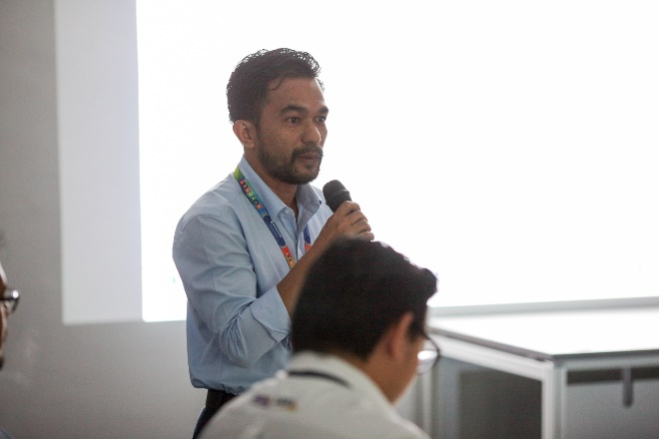
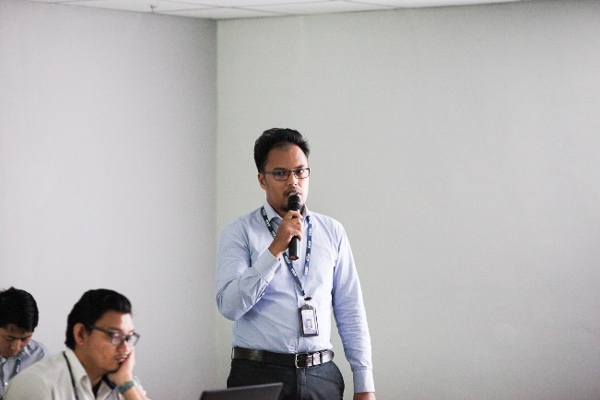
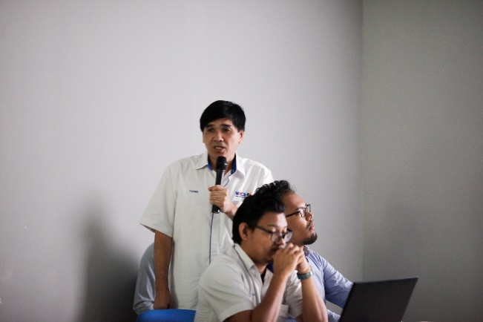
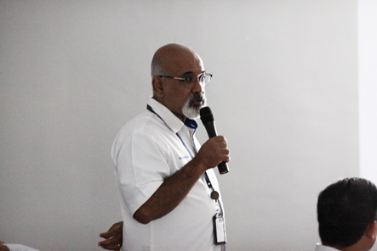
Tender briefing on 24 May 2017 (supply, delivery, installation, testing and commissioning of air conditioning and mechanical ventilation system for Light Rail Transit 3 (LRT3) from Bandar Utama – Johan Setia)
Picture
Mr. Rahizad Rashid, Vice President, Prasarana Rail and Infrastructure Projects Sdn Bhd (PRAISE), delivering the opening remarks.
Mr. Fadli Naim Md Yusop, Engineer, Infrastructure Construction Management, MRCBGK, presenting on the technical aspects of the air conditioning and mechanical ventilation system package.
Mr. Thong Chong Yong, Senior Manager, Contracts Management, MRCBGK, presenting on the tender requirements.
Mr. Ravendran Rasalingam, General Manager, quality assurance and quality control (QAQC), MRCBGK, presenting on the need for quality assurance and quality control.

Slide 8
Events
2015
2016
2017
25 May
2017
Tender briefing on 25 May 2017 (supply, delivery, installation, testing and commissioning of lifts for package LIF (Eastern & Western) for Light Rail Transit 3 (LRT3) from Bandar Utama – Johan Setia)
On 25 May 2017, Prasarana Malaysia Berhad (Prasarana) and MRCB George Kent Sdn Bhd (MRCBGK) held a tender briefing for the LRT3’s “supply, delivery, installation, testing and commissioning of lifts for package LIF (Eastern & Western) for Light Rail Transit 3 (LRT3) from Bandar Utama – Johan Setia”. Present at the briefing were Mr. Yazid Ahad, Vice President, Prasarana Rail and Infrastructure Projects Sdn Bhd (PRAISE); Mr. Chan Wai Loon, Design Engineer, Infrastructure, Engineering & Design Department (IED), MRCBGK; Mr. Mohd Salahuddin Yaacob, Senior Manager, Environmental, Safety & Health (ESH), MRCBGK; Mr. Thong Chong Yong, Senior Manager, Contracts Management, MRCBGK and Mr. Ravendran Rasalingam, General Manager, quality assurance and quality control (QAQC), MRCBGK.
Event Gallery

Slide 9
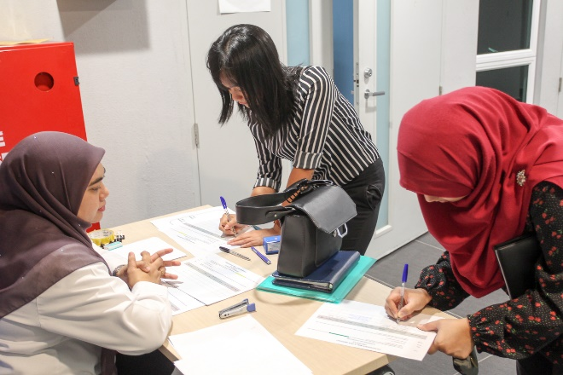
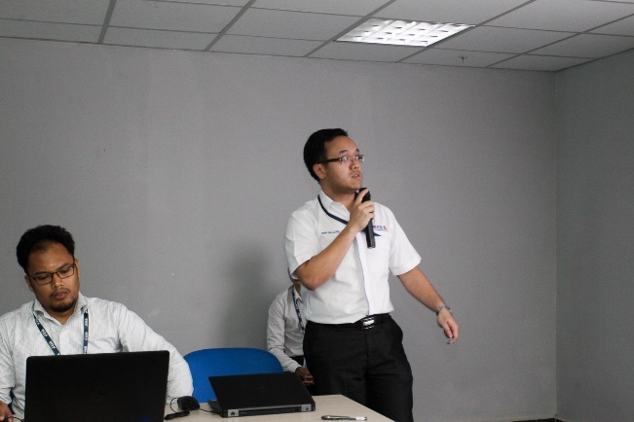
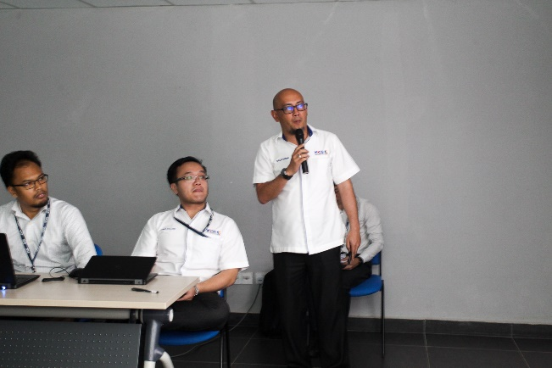
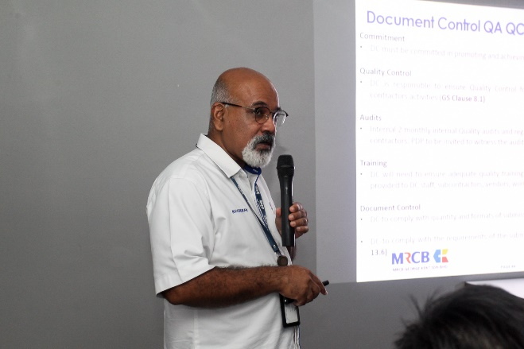
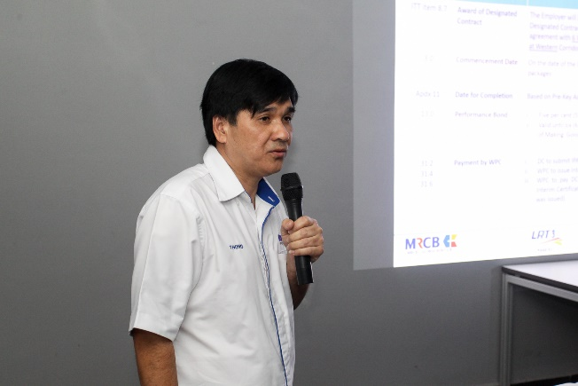
Tender briefing on 25 May 2017 (supply, delivery, installation, testing and commissioning of lifts for package LIF (Eastern & Western) for Light Rail Transit 3 (LRT3) from Bandar Utama – Johan Setia)
Picture
Representatives from pre-qualified contractors registering their attendance.
Mr. Chan Wai Loon, Design Engineer, Infrastructure, Engineering & Design Department (IED), MRCBGK, presenting on the technical aspects of the package.
Mohd Salahuddin Yaacob, Senior Manager, Environmental, Safety & Health (ESH), MRCBGK, presenting on the package’s ESH requirements.
Mr. Ravendran Rasalingam, General Manager, quality assurance and quality control (QAQC), MRCBGK, presenting on the need for quality assurance and quality control.
Mr. Thong Chong Yong, Senior Manager, Contracts Management, MRCBGK, presenting on the tender requirements.

Slide 10
Events
2015
2016
2017
25 May
2017
Tender briefing on 25 May 2017 (supply, delivery, installation, testing and commissioning of escalators for package ESC (Eastern & Western) Light Rail Transit 3 (LRT3) from Bandar Utama – Johan Setia)
On 25 May 2017, Prasarana Malaysia Berhad (Prasarana) and MRCB George Kent Sdn Bhd (MRCBGK) held a tender briefing for the “supply, delivery, installation, testing and commissioning of escalators for package ESC (Eastern & Western) for Light Rail Transit 3 (LRT3) from Bandar Utama – Johan Setia”. Present at the briefing were Mr. Rahizad Rashid, Vice President, Prasarana Rail and Infrastructure Projects Sdn Bhd (PRAISE); Mr. Chan Wai Loon, Design Engineer, Infrastructure, Engineering & Design Department (IED), MRCBGK; Mr. Thong Chong Yong, Senior Manager, Contracts Management, MRCBGK and Mr. Noeh Niqmann Zainal Abidin, certified integrity officer, Prasarana.
Event Gallery

Slide 11
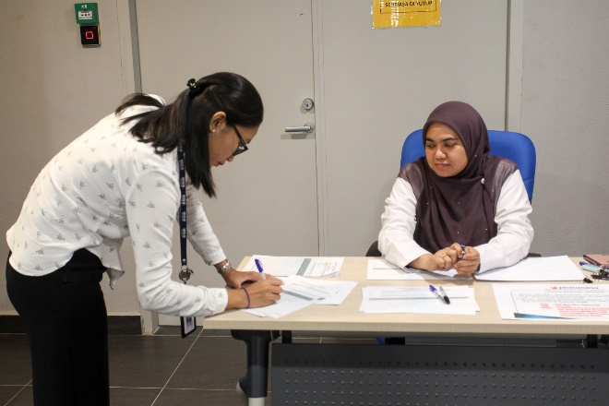
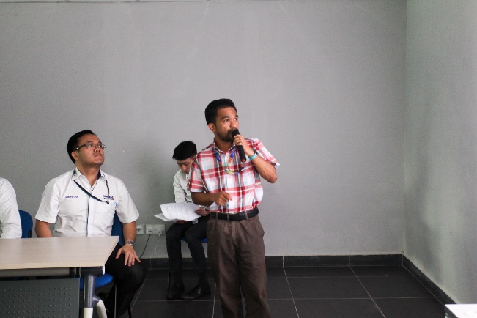
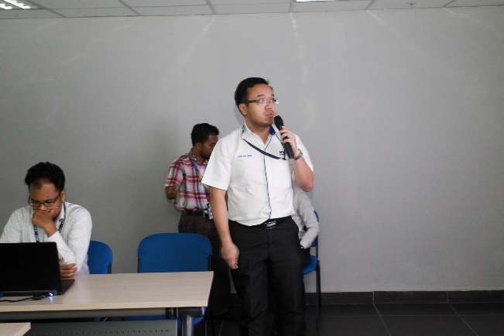
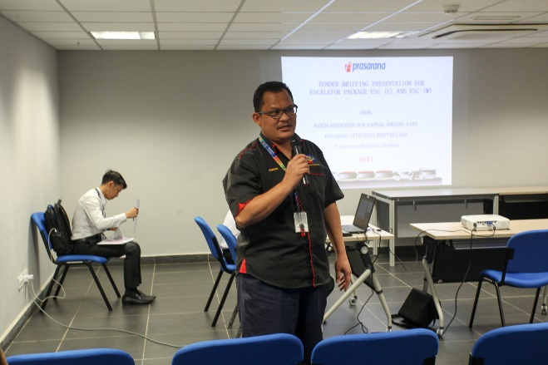
Tender briefing on 25 May 2017 (supply, delivery, installation, testing and commissioning of escalators for package ESC (Eastern & Western) Light Rail Transit 3 (LRT3) from Bandar Utama – Johan Setia)
Picture
Representatives from pre-qualified contractors registering their attendance.
Mr. Rahizad Rashid, Vice President, Prasarana Rail and Infrastructure Projects Sdn Bhd (PRAISE), delivering the opening remarks.
Mr. Chan Wai Loon, Design Engineer, Infrastructure, Engineering & Design Department (IED), MRCBGK, presenting on the technical aspects of the package.
Mr. Noeh Niqman Zainal Abidin, certified integrity officer, Prasarana, presenting on the integrity aspects that all pre-qualified contractors need to adhere to.

Slide 12
www.lrt3.com

